Slide 1
Azure IoT complete Backend
Build complete backend solution for your IoT Projects in
Microsoft Azure Bret Stateham
Bret.Stateham@Microsoft.com
@BretStateham
https://aka.ms/ingenu2azure

Slide 2
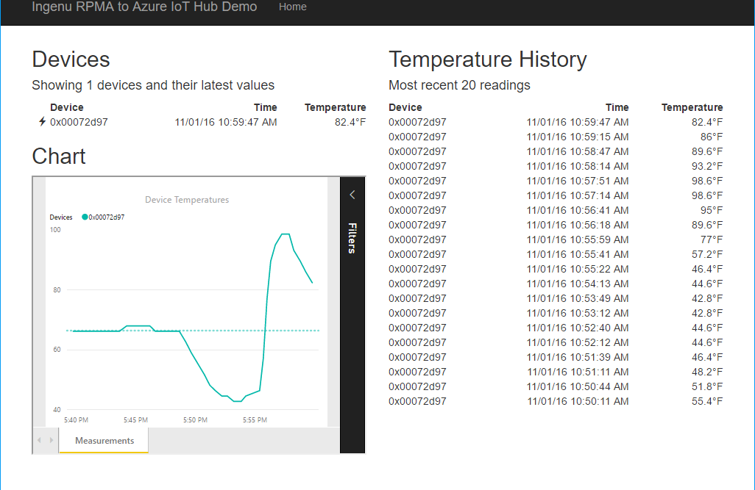


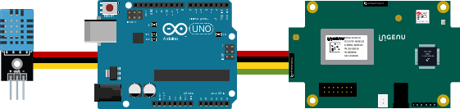
Resource Group <name>group
Power BI Embedded Collection ingenucollection
Power BI Embedded Workspace Dynamic GUID
RENDER
Power BI Report Temperature Chart
Storage Account ingenustorage
App Service Plan ingenuplan
READ/WRITE
Function App ingenufunctions
GET
Web App ingenuweb
QUERY
Function EventHub2IntellectRestJS
Function IntellectRest2IoTHubJs
QUERY
Service Bus Namespace ingenubus
SQL Server ingenusql
RECEIVE
SQL Database
ingenudb
Event Hub
ingenualerts
SEND
OUTPUT
OUTPUT
Stream Analytics Job ingenujob
POST
GET
AZURE
INPUT
RPMA to Azure
Architecture Diagram
IoT Hub ingenuhub
Ingenu Intellect Platform - REST or AMQP
INGENU
BACKHAUL
Ingenu RPMA Access Point
UPLINK
DOWNLINK
FIELD

Slide 3
Resource Group <name>group
Power BI Embedded Collection ingenucollection
Power BI Embedded Workspace Dynamic GUID
RENDER
Power BI Report Temperature Chart
Storage Account ingenustorage
App Service Plan ingenuplan
READ/WRITE
Function App ingenufunctions
GET
Web App ingenuweb
QUERY
Function EventHub2IntellectRestJS
Function IntellectRest2IoTHubJs
QUERY
Service Bus Namespace ingenubus
SQL Server ingenusql
RECEIVE
SQL Database
ingenudb
Event Hub
ingenualerts
SEND
OUTPUT
OUTPUT
Stream Analytics Job ingenujob
POST
GET
AZURE
INPUT
RPMA to Azure
Architecture Diagram
IoT Hub ingenuhub
Ingenu Intellect Platform - REST or AMQP
INGENU
BACKHAUL
Ingenu RPMA Access Point
UPLINK
DOWNLINK
FIELD

Slide 4

Ingenu & rpma
www.ingenu.com

Slide 5


Slide 6
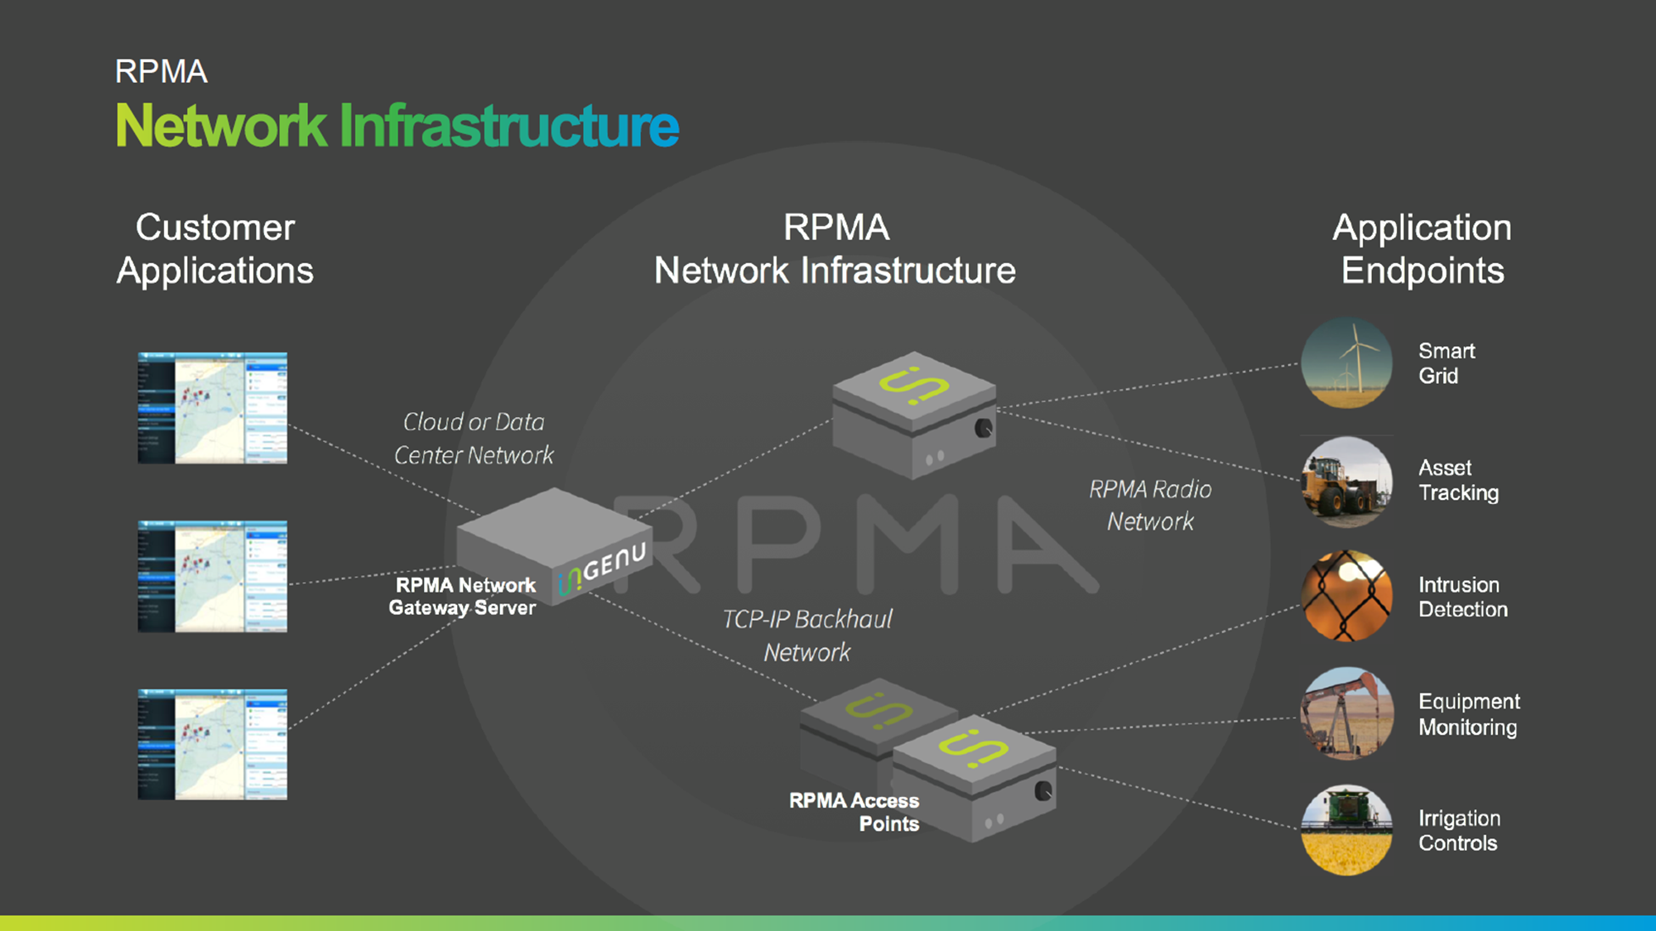

Slide 7
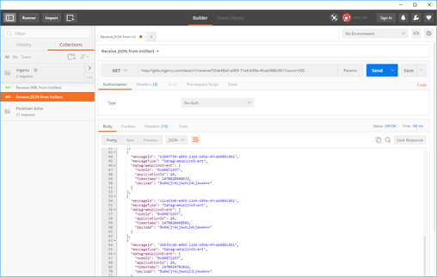
GET
AZURE
RPMA to Azure
Architecture Diagram
Ingenu Intellect Platform - REST or AMQP
INGENU
BACKHAUL
Ingenu RPMA Access Point
UPLINK
FIELD

Slide 8
Pulling device data out of Intellect via REST
https://aka.ms/ingenu2azure

Slide 9
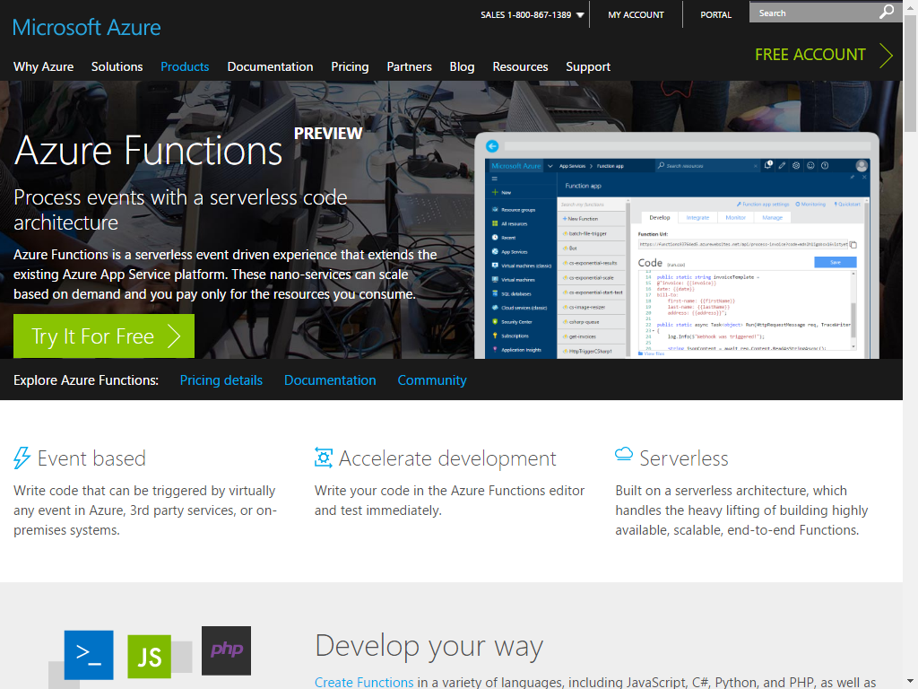
Azure functions
Process events with a serverless code architecture
Azure functions is a serverless event driven experience that extends the existing Azure App Service platform. These nano-services can scale based on demand and you pay only for the resources you consume.
https://aka.ms/ingenu2azure

Slide 10
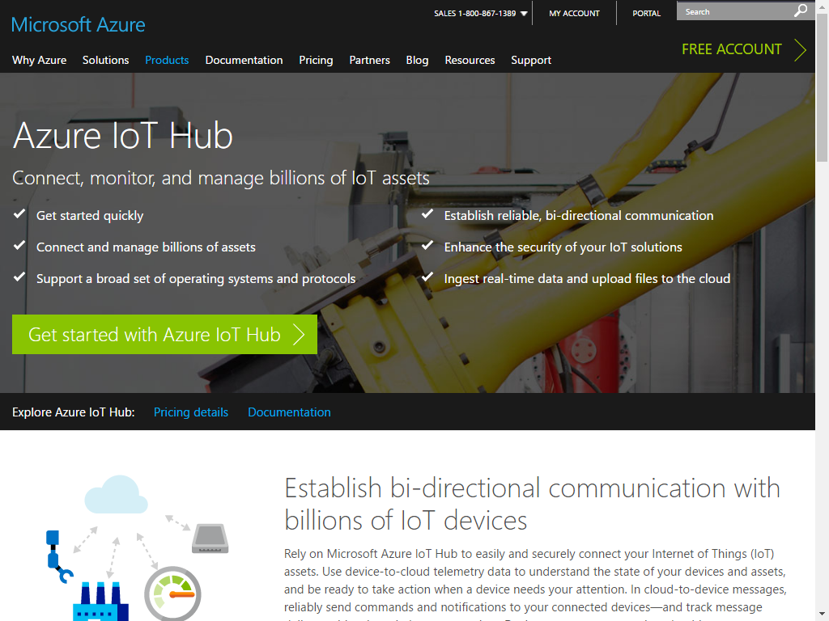
Azure IoT Hub
Establish secure bi-directional communication with billions of IoT devices.
Work with familiar protocols like HTTPS, AMQPs, and MQTTS
Work with familiar languages like C#, C++, JavaScript, Java & Python
https://aka.ms/ingenu2azure

Slide 11
Resource Group <name>group
Storage Account ingenustorage
App Service Plan ingenuplan
READ/WRITE
Function App ingenufunctions
Function IntellectRest2IoTHubJs
SEND
GET
AZURE
RPMA to Azure
Architecture Diagram
IoT Hub ingenuhub
Ingenu Intellect Platform - REST or AMQP
INGENU
BACKHAUL
Ingenu RPMA Access Point
UPLINK
FIELD

Slide 12
Demo the Azure Function and IoT Hub
https://aka.ms/ingenu2azure

Slide 13
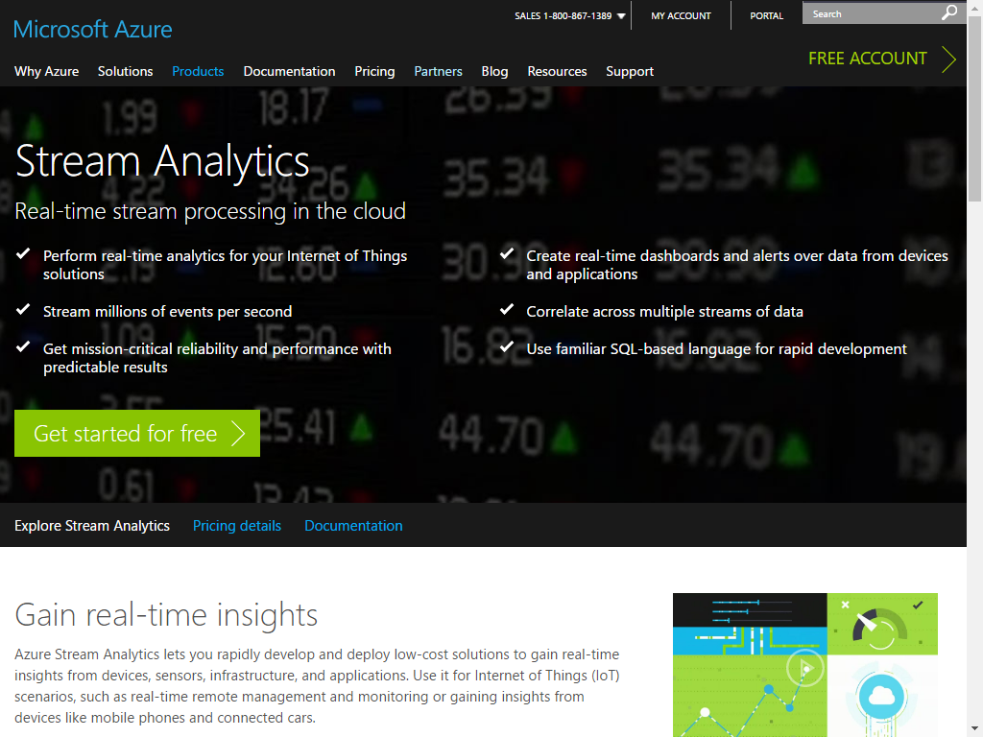
Azure Stream analytics
Real-time stream processing in the cloud.
Perform real-time analytics for your IoT Solutions
Stream millions of events per second
Use familiar SQL-based language for Rapid Development
https://aka.ms/ingenu2azure

Slide 14
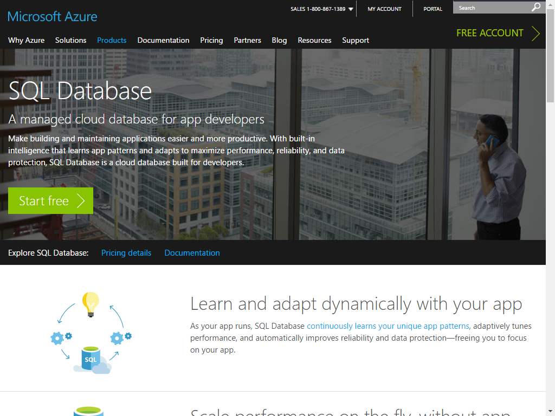
Azure SQL Database
A managed cloud database for app developers
Make building and maintaining applications easier and more productive. With built-in intelligence that learns app patterns and adapts to maximize performance, reliability, and data protection, SQL Database is a cloud database built for developers.
https://aka.ms/ingenu2azure

Slide 15
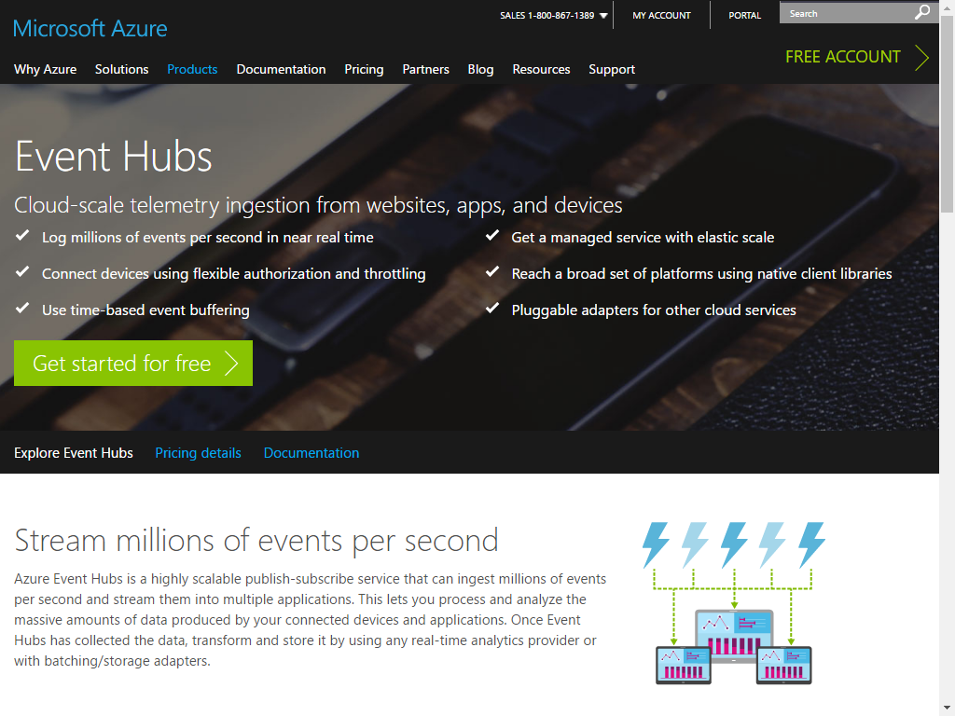
Azure Event Hubs
Stream millions of events per second
Azure Event Hubs is a highly scalable publish-subscribe service that can ingest millions of events per second and stream them into multiple applications. This lets you process and analyze the massive amounts of data produced by your connected devices and applications. Once Event Hubs has collected the data, transform and store it by using any real-time analytics provider or with batching/storage adapters.
https://aka.ms/ingenu2azure

Slide 16
Resource Group <name>group
Storage Account ingenustorage
App Service Plan ingenuplan
READ/WRITE
Function App ingenufunctions
Function IntellectRest2IoTHubJs
SQL Server ingenusql
Service Bus Namespace ingenubus
SQL Database
ingenudb
Event Hub
ingenualerts
SEND
OUTPUT
OUTPUT
Stream Analytics Job ingenujob
GET
AZURE
INPUT
RPMA to Azure
Architecture Diagram
IoT Hub ingenuhub
Ingenu Intellect Platform - REST or AMQP
INGENU
BACKHAUL
Ingenu RPMA Access Point
UPLINK
FIELD

Slide 17
Stream Analytics, SQL DB & Event Hubs
https://aka.ms/ingenu2azure

Slide 18
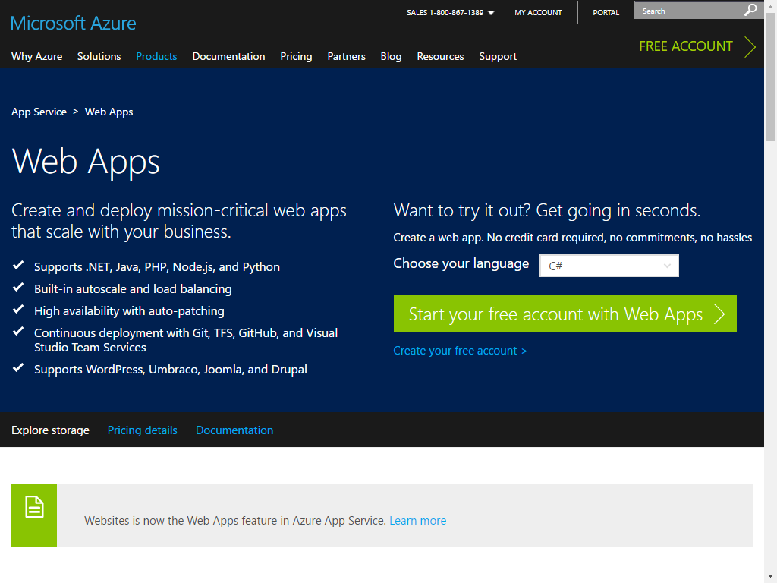
Azure Web Apps
Create and deploy mission-critical web apps that scale with your business.
Supports .NET, Java, PHP, Node.js, and Python
Built-in autoscale and load balancing
Continuous Deployment with Git, TFS, GitHub and Visual Studio Team Services
https://aka.ms/ingenu2azure

Slide 19
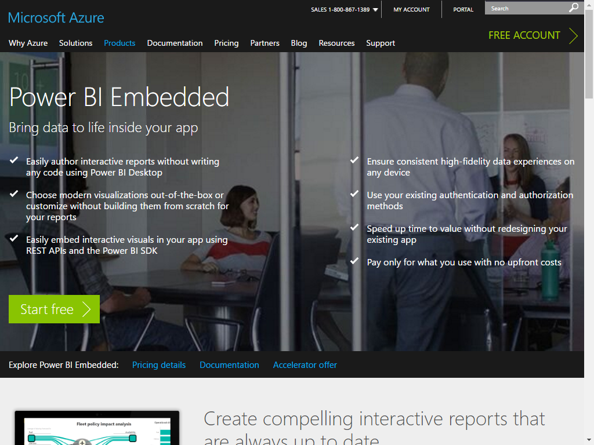
Power BI Embedded
Create compelling interactive reports that are always up to date
Power BI Embedded lets you create visually impactful and interactive reports against your application data in Power BI Desktop—without writing any code. Easily explore your application data through a freeform, drag-and-drop canvas and produce rich data models using formulas and relationships
https://aka.ms/ingenu2azure

Slide 20
Resource Group <name>group
Power BI Embedded Collection ingenucollection
Power BI Embedded Workspace Dynamic GUID
RENDER
Power BI Report Temperature Chart
Storage Account ingenustorage
App Service Plan ingenuplan
READ/WRITE
Function App ingenufunctions
GET
Web App ingenuweb
QUERY
Function IntellectRest2IoTHubJs
QUERY
Service Bus Namespace ingenubus
SQL Server ingenusql
SQL Database
ingenudb
Event Hub
ingenualerts
SEND
OUTPUT
OUTPUT
Stream Analytics Job ingenujob
GET
AZURE
INPUT
RPMA to Azure
Architecture Diagram
IoT Hub ingenuhub
Ingenu Intellect Platform - REST or AMQP
INGENU
BACKHAUL
Ingenu RPMA Access Point
UPLINK
FIELD

Slide 21
Web App and Power BI Embedded
https://aka.ms/ingenu2azure

Slide 22
Sending cloud-to-device messages
The last step in the demo.
We’ll act on the alerts that made it into our alerts event hub, and send alert messages back down to the device.
https://aka.ms/ingenu2azure

Slide 23
Resource Group <name>group
Power BI Embedded Collection ingenucollection
Power BI Embedded Workspace Dynamic GUID
RENDER
Power BI Report Temperature Chart
Storage Account ingenustorage
App Service Plan ingenuplan
READ/WRITE
Function App ingenufunctions
GET
Web App ingenuweb
QUERY
Function EventHub2IntellectRestJS
Function IntellectRest2IoTHubJs
QUERY
Service Bus Namespace ingenubus
SQL Server ingenusql
RECEIVE
SQL Database
ingenudb
Event Hub
ingenualerts
SEND
OUTPUT
OUTPUT
Stream Analytics Job ingenujob
POST
GET
AZURE
INPUT
RPMA to Azure
Architecture Diagram
IoT Hub ingenuhub
Ingenu Intellect Platform - REST or AMQP
INGENU
BACKHAUL
Ingenu RPMA Access Point
UPLINK
DOWNLINK
FIELD

Slide 24
Sending Cloud to Device Messages
https://aka.ms/ingenu2azure

Slide 25
Resource Group <name>group
Power BI Embedded Collection ingenucollection
Power BI Embedded Workspace Dynamic GUID
RENDER
Power BI Report Temperature Chart
Storage Account ingenustorage
App Service Plan ingenuplan
READ/WRITE
Function App ingenufunctions
GET
Web App ingenuweb
QUERY
Function EventHub2IntellectRestJS
Function IntellectRest2IoTHubJs
QUERY
Service Bus Namespace ingenubus
SQL Server ingenusql
RECEIVE
SQL Database
ingenudb
Event Hub
ingenualerts
SEND
OUTPUT
OUTPUT
Stream Analytics Job ingenujob
POST
GET
AZURE
INPUT
RPMA to Azure
Architecture Diagram
IoT Hub ingenuhub
Ingenu Intellect Platform - REST or AMQP
INGENU
BACKHAUL
Ingenu RPMA Access Point
UPLINK
DOWNLINK
FIELD

Slide 26
Resource Group <name>group
Power BI Embedded Collection ingenucollection
Power BI Embedded Workspace Dynamic GUID
Power BI Report Temperature Chart
Storage Account ingenustorage
App Service Plan ingenuplan
READ/WRITE
Function App ingenufunctions
Web App ingenuweb
QUERY
Function EventHub2IntellectRestJS
Function IntellectRest2IoTHubJs
QUERY
Service Bus Namespace ingenubus
SQL Server ingenusql
RECEIVE
SQL Database
ingenudb
Event Hub
ingenualerts
SEND
OUTPUT
OUTPUT
Stream Analytics Job ingenujob
POST
GET
AZURE
INPUT
IoT Hub ingenuhub
Ingenu Intellect Platform - REST or AMQP
INGENU
BACKHAUL
Ingenu RPMA Access Point
UPLINK
DOWNLINK
FIELD

Slide 27
Azure IoT complete Backend
Build complete backend solution for your IoT Projects in
Microsoft Azure Bret Stateham
Bret.Stateham@Microsoft.com
@BretStateham
https://aka.ms/ingenu2azure

Slide 29
IoT Logo

Slide 30
arduino

Slide 31
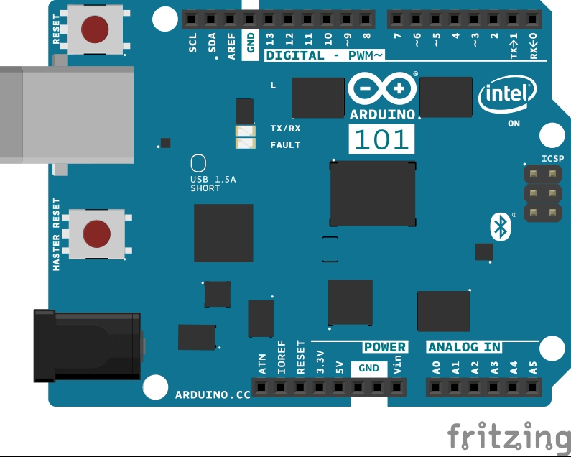
Arduino 101

Slide 32
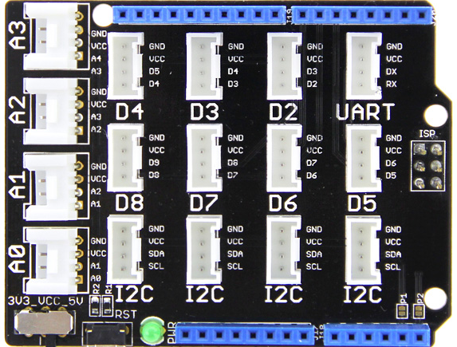
Grove Base Shield

Slide 33
Grove cable & SENSORS

Slide 34
Grove cable & SENSORS

Slide 35
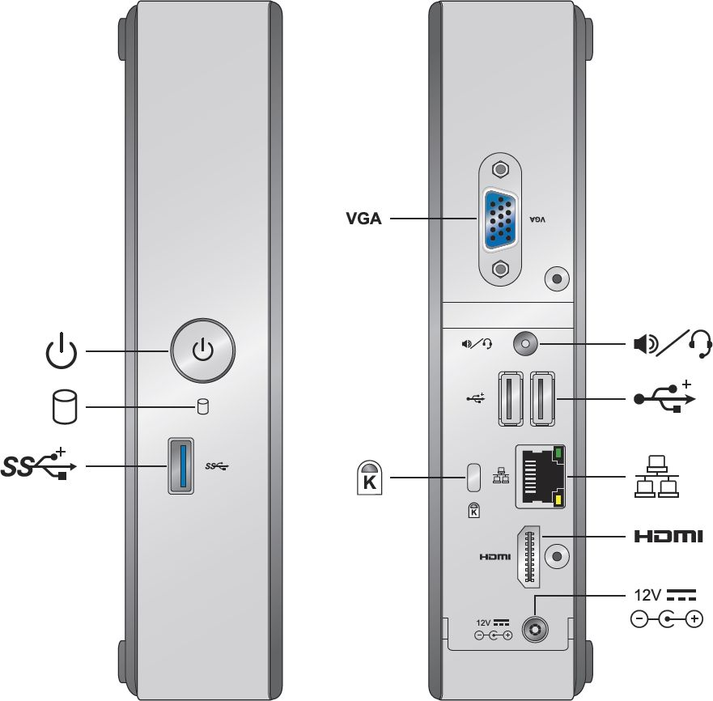
INTEL NUC DE3815TYKE

Slide 36
GALILEO BOARD

Slide 37
RASPBERRY PI

Slide 38
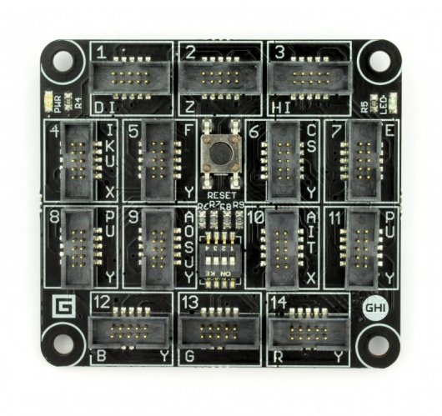
FEZ SPIDER MAIN BOARD

Slide 39
Sparkfun weather shield

Slide 40
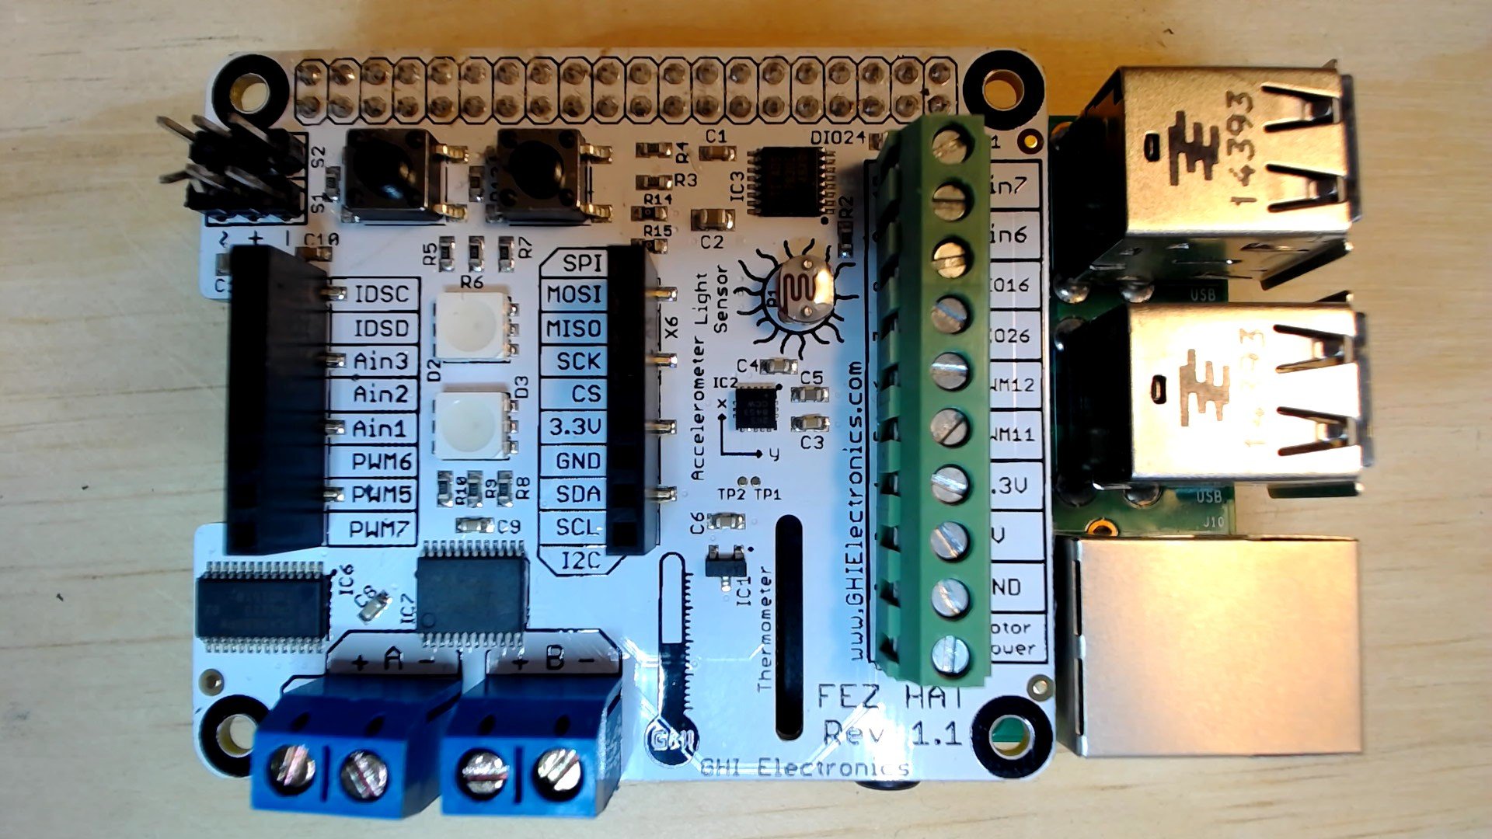
FEZ HAT

Slide 41
Connect the dots azure icons
Event Hubs
Stream Analytics
Storage
(
Azure
Microsoft Azure
Web App
Service Bus
)
Storage blob
Storage table
SQL database
HDInsight
Machine
(
Learning
GitHub code
Git repository
generic
)

Slide 42
LEDs

Slide 43
Resistors
220Ω
1st Digit
2nd Digit
Multiplier
Tolerance
Color | Name | 1st Digit | 2nd Digit | Multiplier | Tolerance
 | Black | 0 | 0 | X1
 | Brown | 1 | 1 | X10 | 1%
 | Red | 2 | 2 | X100
 | Orange | 3 | 3 | X1,000
 | Yellow | 4 | 4 | X10,000
 | Green | 5 | 5 | X100,000
 | Blue | 6 | 6 | X1,000,000
 | Violet | 7 | 7
 | Grey | 8 | 8
 | White | 9 | 9
 | Gold |  |  | X0.1 | 5%
 | Silver |  |  | X0.01 | 10%
330Ω
10KΩ

Slide 44
cables

Slide 45
More cables and adapters

Slide 46

LEDs
Anode (+)
Cathode (-)
Flat Edge
Small Post
Big Post
Long Leg
Short Leg
Vcc (+)
GND

Slide 47
LEDs

Slide 48
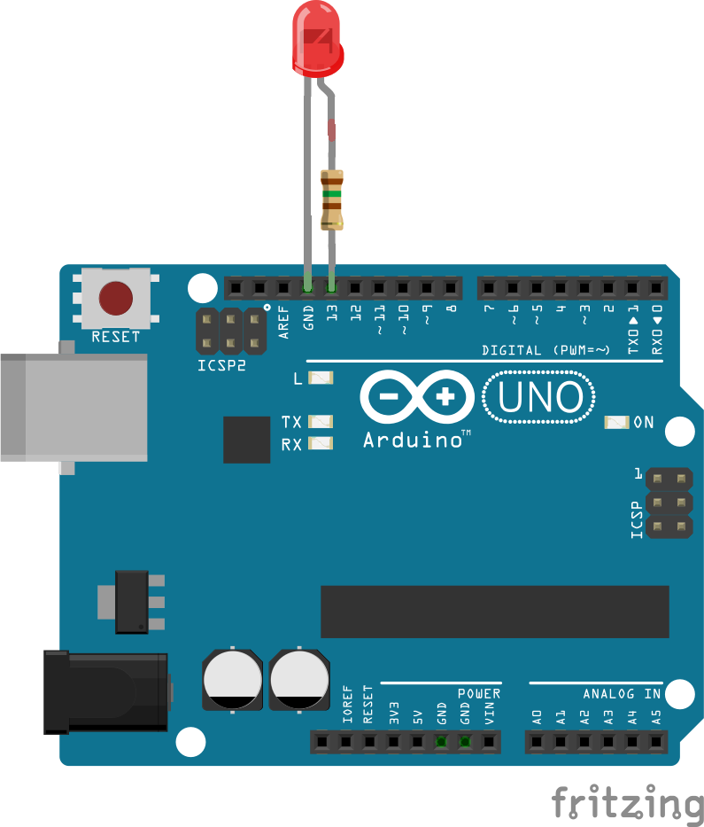

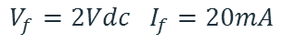
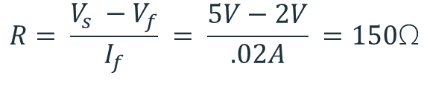
Current limiting resistors
Providing more current than an LED is rated for can destroy the LED. To prevent that, you should use a “Current Limiting” resistor.
To calculate the value of the resistor you need to know the supply voltage (Usually 5V on the Arduino Uno), and the LEDs rated Forward Voltage (the voltage drop across the LED) and Forward Current (the maximum current the LED can handle).
$$V_{f}=2Vdc I_{f}=20mA$$
$$Resistor Value (R)= \frac{Supply Voltage \left(V_{s}\right)−LED Forward Voltage (V_{f}) }{LED Forward Current (I_{f})}$$
$$V_{s}=5Vdc$$
$$R= \frac{V_{s} −V_{f}}{I_{f}} = \frac{5V−2V}{.02A} =150\text{Ω}$$
The Arduino Uno has a built in current limiting resistor on Pin 13. If you use Pin 13 to power your LED you can use it without a separate resistor.

Slide 49
Resistors
220Ω
1st Digit
2nd Digit
Multiplier
Tolerance
Color | Name | 1st Digit | 2nd Digit | Multiplier | Tolerance
 | Black | 0 | 0 | X1
 | Brown | 1 | 1 | X10 | 1%
 | Red | 2 | 2 | X100
 | Orange | 3 | 3 | X1,000
 | Yellow | 4 | 4 | X10,000
 | Green | 5 | 5 | X100,000
 | Blue | 6 | 6 | X1,000,000
 | Violet | 7 | 7
 | Grey | 8 | 8
 | White | 9 | 9
 | Gold |  |  | X0.1 | 5%
 | Silver |  |  | X0.01 | 10%
330Ω
10KΩ

Slide 50
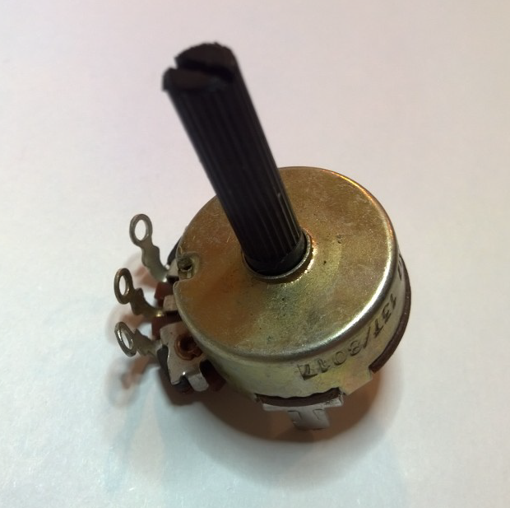
Potentiometer – variable resistor

Slide 51
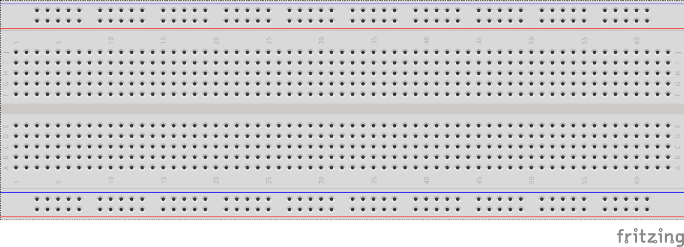
breadboards
Breadboards offer a great way to prototype circuits. The provide a number of “buses” for connecting both power and components.
Power buses run the entire horizontal length
Component buses give you easy ways to connect pins together

Slide 54
Micro SD Cards
Font: Segoe UI Semibold

